Slide 1
Python programming workshop
Dr. Emily Johnson

Slide 2
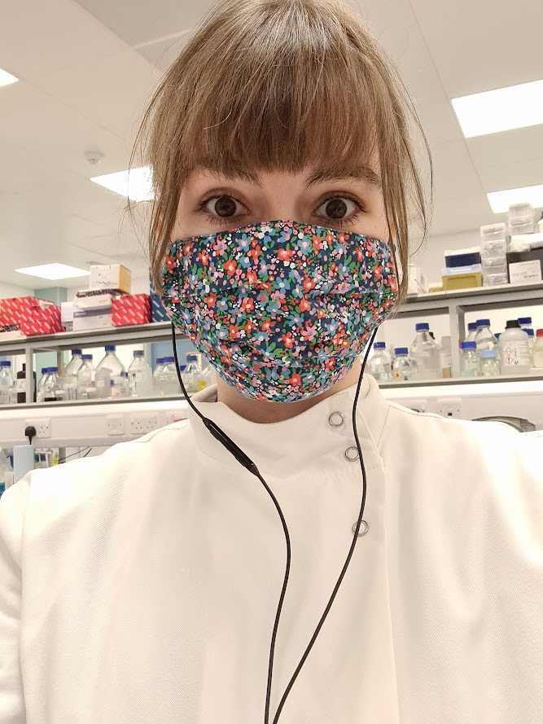
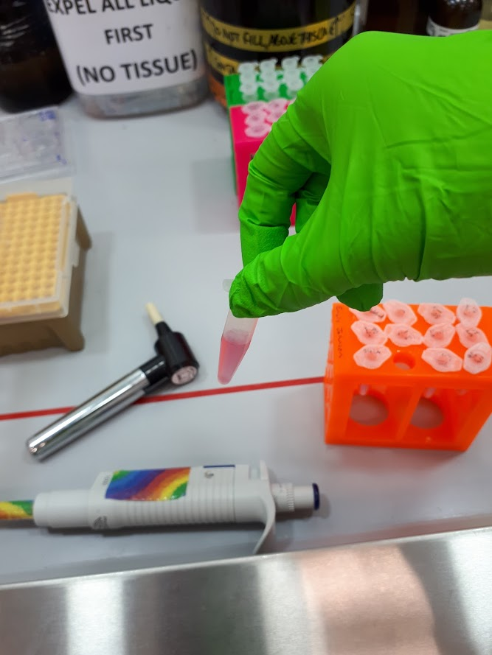
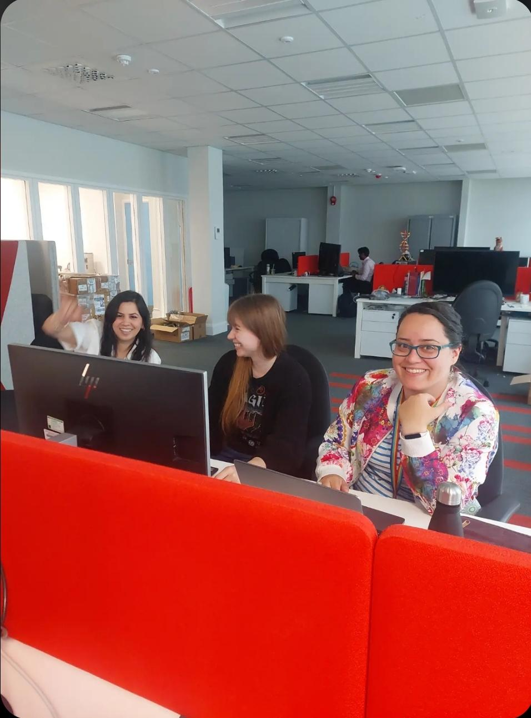
Who am I?
Notes:
/who are we slide that can be modified depending on who comes with me

Slide 3
Purpose of today
To teach you a little bit about ageing and how long animals can live for
To give you an introduction to Python
Note:
These activities are still under active development! You will be the first group we run them with!

Slide 4

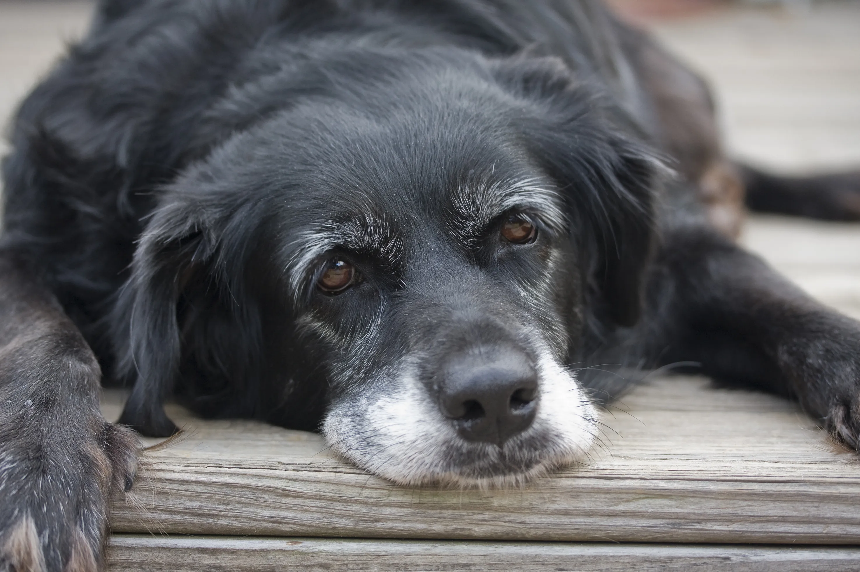
Notes:
What is the oldest animal you can think of? Any animal at all?

Slide 5
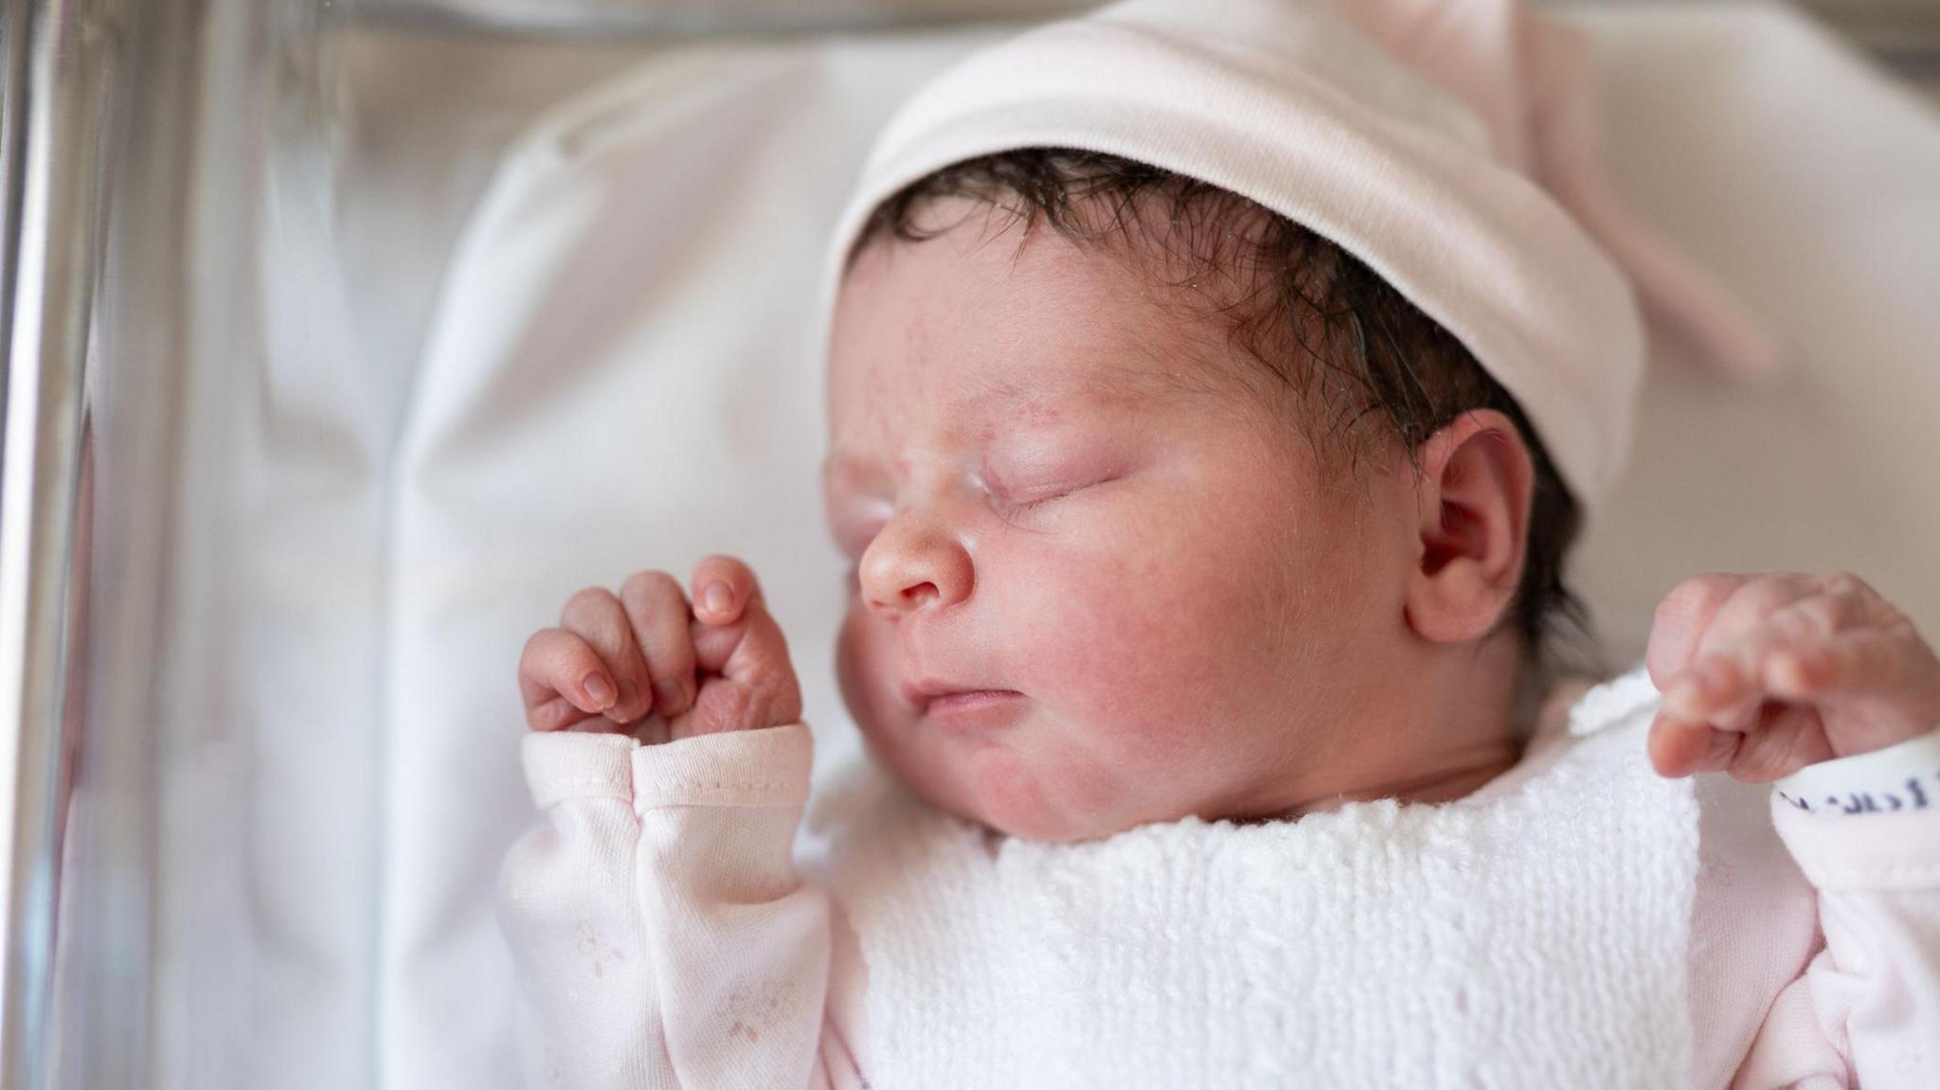
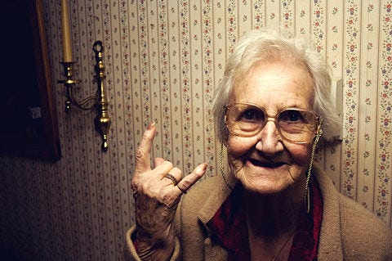
Notes:
What is the oldest animal you can think of? Any animal at all?

Slide 6
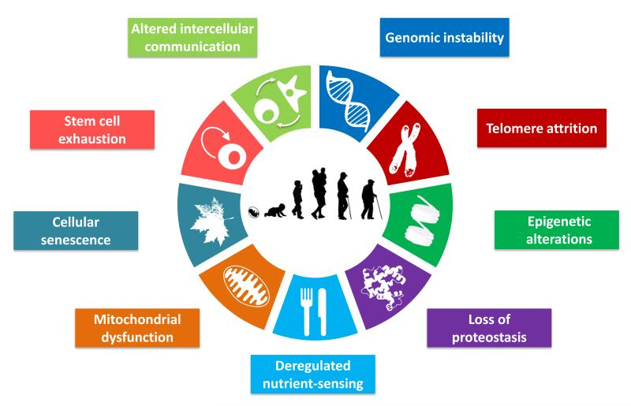


Slide 7
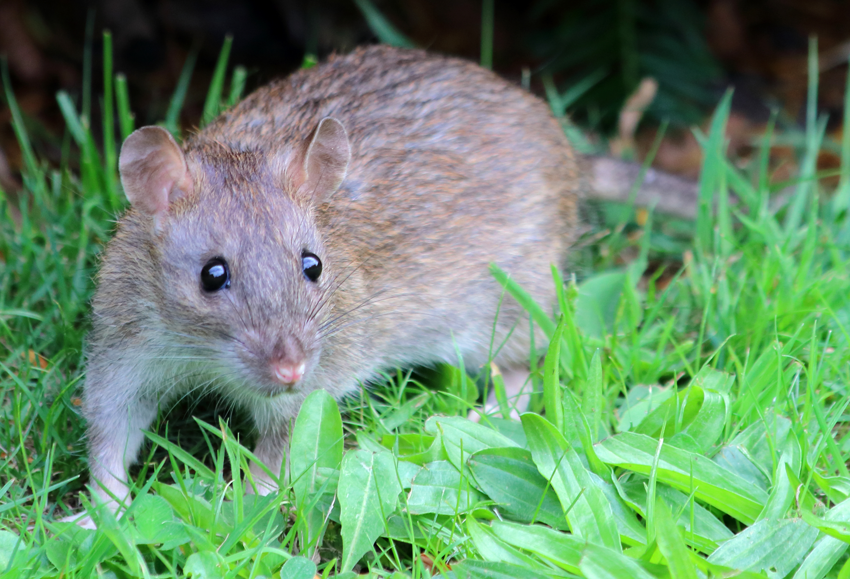
Notes:
Easy one to start… rat… 3.8 yrs

Slide 8
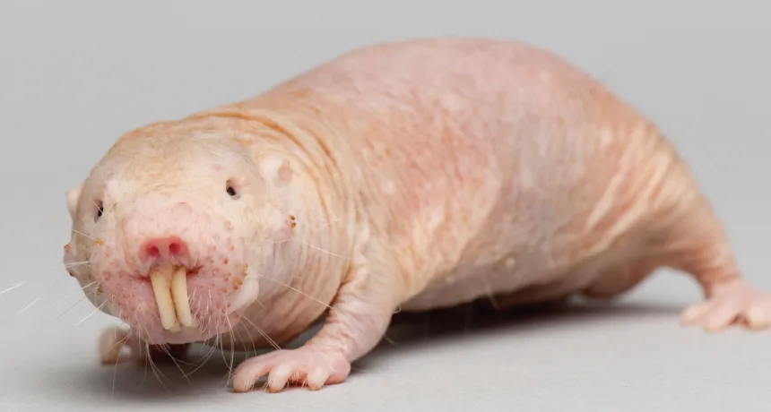
Notes:
This is a naked mole rat, how old do you think he can live for?
31 years, this is an insanely long time for a rodent.

Slide 9
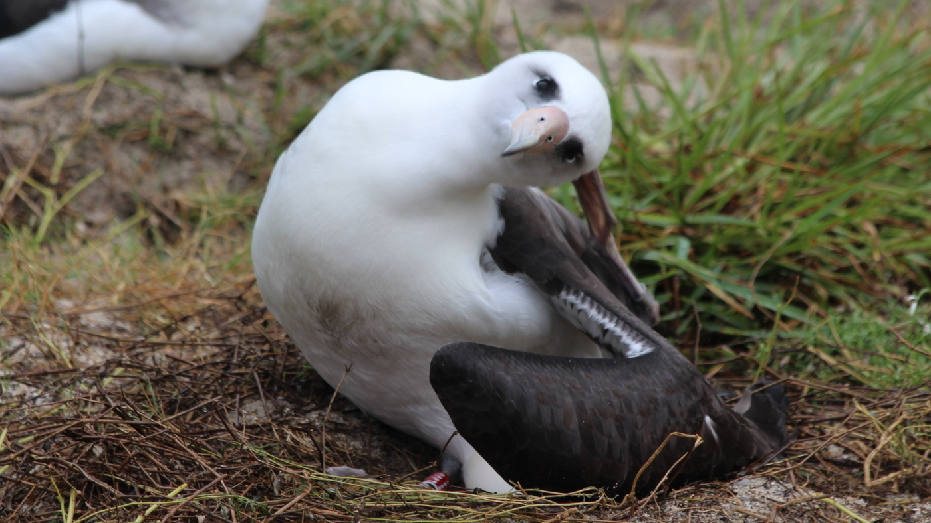
Notes:
This is a laysan albatross – any guesses on how long they can live?
This particular albatross is actually a famous bird called Wisdom, she is 74 years old and still laying eggs!

Slide 10
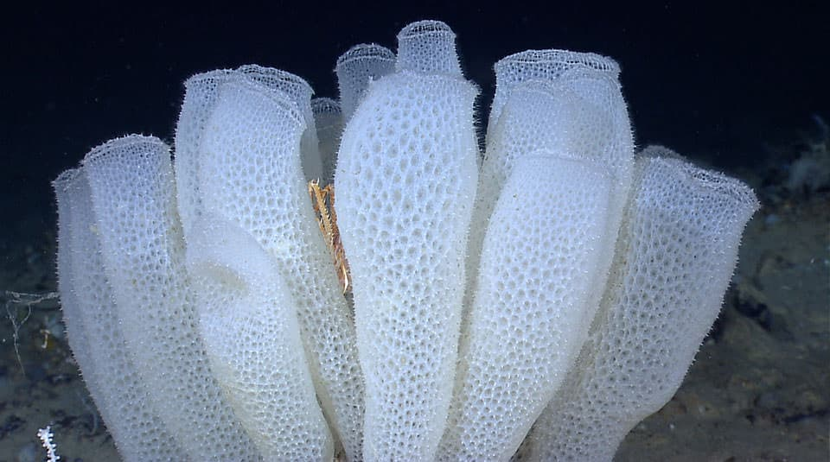
Notes:
Finally, here is a glass sponge, they live around Antartica. Anyone want to have a guess how long they live for?
…..these sponges are estimated to live 15,000 years!!!

Slide 11
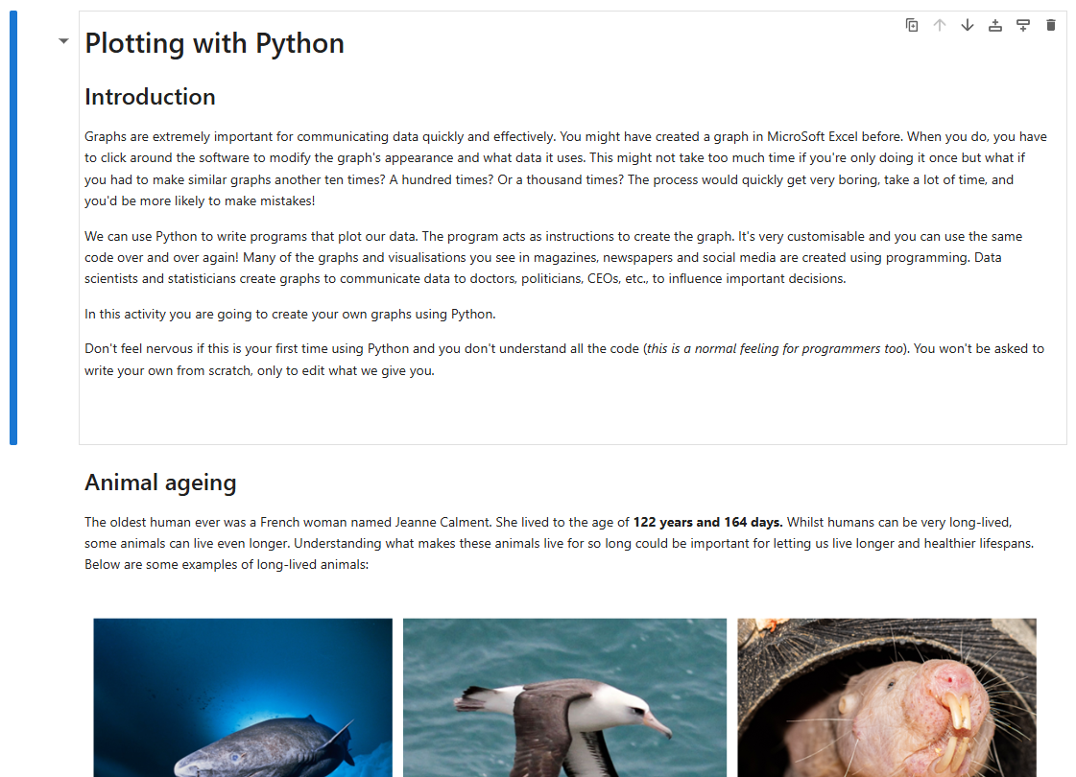
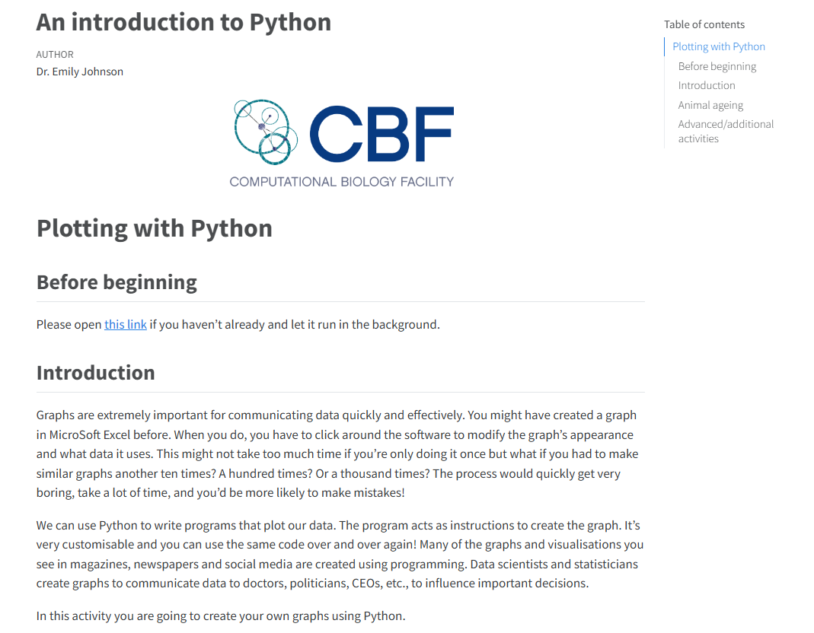
The activity
Type this into your browser: https://tinyurl.com/animal-ageing

Slide 12
Quick tip
Highlight text and press ctrl + c to ‘copy’
Then press ctrl + v on your keyboard to paste!

Slide 13
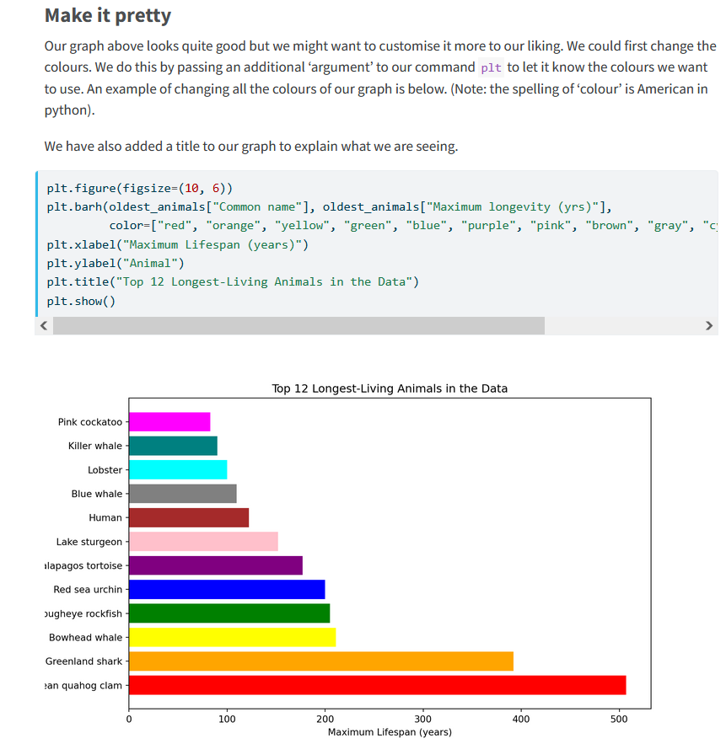
Competition!
After you finish this section ‘make it pretty’ you’ll have learned to have customized your graphs
We’d like to challenge you to either create the prettiest or ugliest graph you can
Please email ‘Emily.johnson@liverpool.ac.uk’ with the subject line:
‘Pretty graph – [YOUR NAME]’ or
‘Ugly graph – [YOUR NAME]’ with the graph either pasted or as an attachment, raise your hands if you’re stuck/need help ☺
https://tinyurl.com/animal-graphs

Slide 14
Thank you!!
Please take 5 minutes to give us feedback! Write on the back of the sheet if you run out of room. We’d like any ideas on how to make it funner/more engaging and whether the difficulty was too hard or just right. ☺
Really well done, this was a difficult activity resembling a real world programming scenario with real data!

